Slide 1
PQVP AD-DS Refresh
State of California

Slide 2
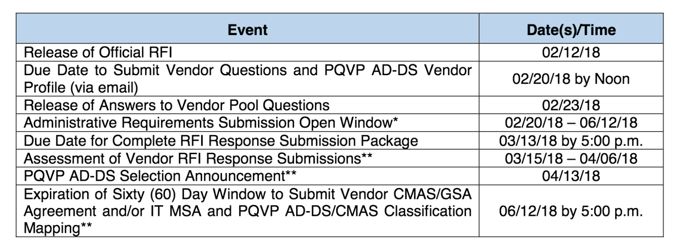

Slide 3
Prototype and 2000 Word Tech Approach
Vendors must publish all prototype source code, design assets, and all associated documentation that they used to satisfy all facets to an online and publicly-accessible GitHub repository.
Posting a repository in a different version control system will not be accepted and may disqualify a Vendor.
Vendors are allowed, and encouraged, to include any kind of documentation in the repository, including photographs, screenshots, or notes on their development and design process:
The timestamp of the most recent commit to the branch in the canonical repository to be reviewed will be the source that determines the timeliness of the delivery.
The submitted Working Prototype and supporting Technical Approach artifacts shall be preserved, without modification, for a minimum of thirty (30) calendar days after the PQVP DS-AD Selection Announcement. ·

Slide 4
Prototype Requirements
Build a digital service Knowledge Management Tool that will allow State Agencies to capture, archive and manage organizational knowledge from employees and programs. Does not need to implement any authentication or authorization against an external mechanism.
Knowledge Creation - Ability to create knowledge articles (work instructions, packages of content, documents workflows, forms, tables, etc). Be able to provide formatting and role-based security.
Knowledge Sharing - Allow for the promotion of process and information across channels. Ability to create user-defined rules for the creation and management of articles. Trigger escalation for approval & lifecycle management

Slide 5
EPIC/Sprint 0 - Human Centered Design - Robert
Produce at least 2 user test sessions - video taped (silverback)
Iterate at least once after testing (to show improvements)
Produce artifacts to support design - Sketches, mocks etc.
Produce 4 user personas (knowledge users & contributors)
508 Compliance Checked and addressed
Used at least a minimum of three (3) “user-centric design” techniques and/or tools
Create or use a design style guide and/or a pattern library;

Slide 6
EPIC/Sprint 0 - Automation & DevOps Requirements
Used Swagger to document the RESTful API, and provided a link to the Swagger API;
Complied with Section 508 of the Americans with Disabilities Act and WCAG 2.0
Works on multiple devices, and presents a responsive design;
Used at least five (5) modern and open-source technologies, regardless of architectural layer (frontend, backend, etc.)
Deployed to IaaS orPaaS provider, and indicated which provider they used;
Developed automated unit tests for their code

Slide 7
EPIC/Sprint 0 Automation & DevOps - cont.
CI system to automate tests and continuously deployed code
Setup or used configuration management;
Setup or used continuous monitoring
Deployed to open source container, such as Docker
Sufficient documentation to install and run prototype on another machine
Underlying platforms used to create and run the prototype are openly licensed and free of charge.

Slide 8
Epic 11 - Technical Approach Document - Robert
A brief description/narrative, no greater than 2,000 words, of the Technical Approach used to create their Prototype in the README.md file located in the root directory of its GitHub repository. Documentation must show code flow from client UI, to JavaScript library, to REST service to database, pointing to code in the GitHub repository. In addition to the description/narrative above, the Vendor must demonstrate that they followed the US Digital Services Playbook (visit https://playbook.cio.gov or see Attachment 2: US Digital Services Playbook) by providing evidence in the repository.

Slide 9
Non-Acceptable Rating
If a commit is made to the branch subject to review after the RFI Response Submission Package due date;
If the code, or any design asset, of the prototype is changed on the GitHub server after the RFI Response Submission Package due date;
If accessing the prototype via the publicly-available URL identified at the top of the README.md file generates HTTP 4xx or 5xx errors; and/or If Vendors submit additional terms and conditions.

Slide 10
Labor Categories (need 5 at least, more is better)
Product Manager - DevOps Engineer - Technical Architect
Security Engineer - Interaction Designer/User Researcher/Usability Tester
Delivery Manager - Writer/Content Designer/Content Strategist - Agile Coach
Visual Designer - Business Analyst - Front End Web Developer -
Digital Performance Analyst - Backend Web Developer

Slide 11
How we will work?
Trello Board here - https://trello.com/b/Ww8O7aX7/adpq2018
Please take a user story / epic and first break it down (checklist w/tasks)
Feel free to add user stories at will and assign each other!
Coordinate in SLACK: fearless.slack.com
USE ONLY THIS REPO - https://github.com/agilesix/ADPQ

Slide 12
Schedule
Wednesday 2/21/18 | Sprint 0 - Hello World App (with full CI/CD) and all devs can run it locally.
Thurs 2/22/18 | Sprint 1 - Landing page and structure including UI designs
Friday 2/23/18 | Sprint 2 - TBD (maybe learning and advising pages)
Saturday 2/24/18 | Sprint 3 - TBD (maybe wiki function)
2/24-3/4 (part time) | Sprint 3 - Usability Testing & Rework based on testing
3/5-6/18 (part time) | Sprint 5 - Testing, remediation and refinement
3/7-8 | Sprint 6 - Final Changes
Friday 3/9/18 by midnight | CODE Freeze
03/13/18 by 5:00 p.m. | Due Date for Complete RFI Response Submission Package Assessment of Vendor RFI
03/15/18 – 04/06/18 | Response Submissions**
04/13/18 | PQVP AD-DS Selection Announcement**

